Slide 1

Introduction to
FCUP | July 2018

Slide 2

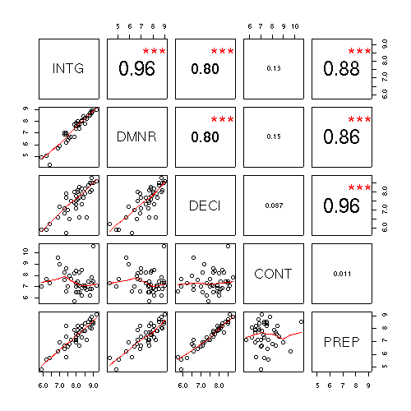
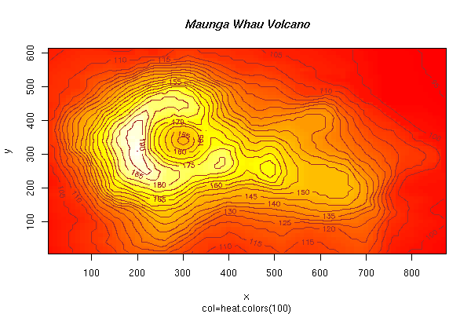
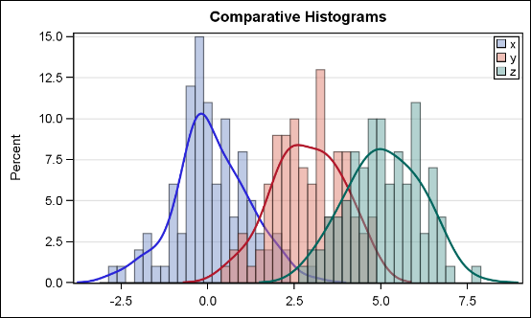
1. So, what is ?
A language and environment for statistical analysis, modelling and data visualization
High-level language based on S
It’s also a compiler (interprets R code)
R is managed by an international ‘core team’ of statisticians and developers
Allows to easily add new functionalities (known as packages)

Slide 3
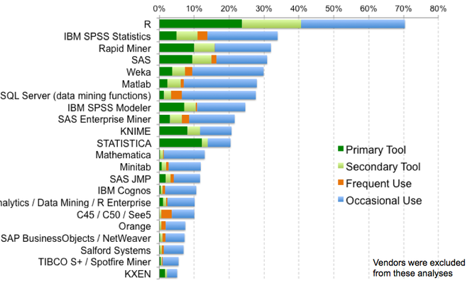
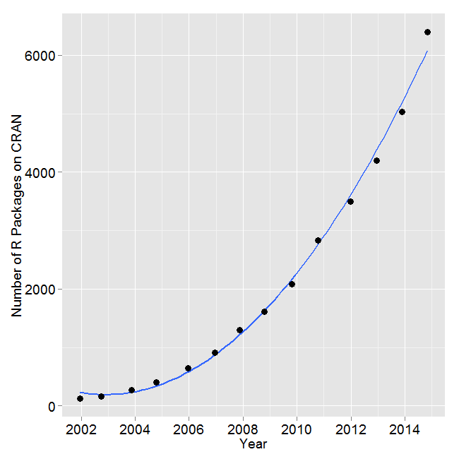
2. Why use R?
Powerful, flexible, extendable, multi-platform, open-source,… - more freedom and power to the user
Several data structures well fitted to statistical analysis and modelling (e.g., ecological data)
A large (and growing) number of statistical methods implemented
Active and increasing community of users and contributors
A large number of support materials from websites to books

Slide 4
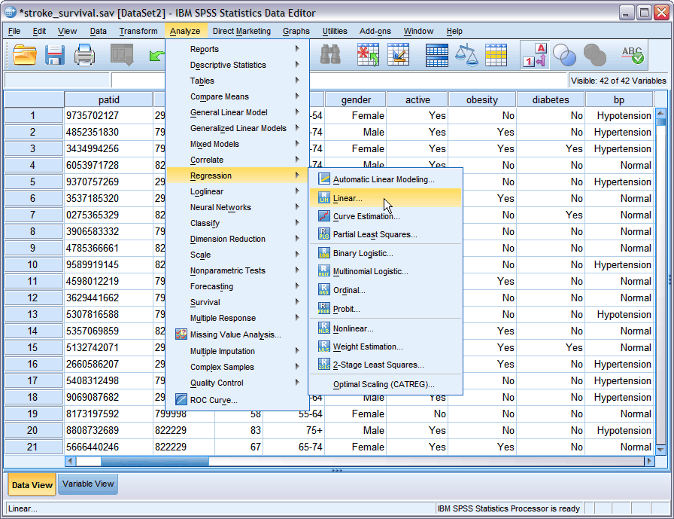
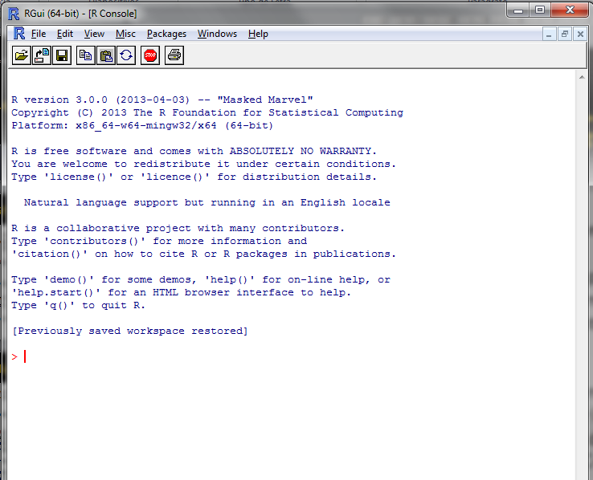
3. R limitations
“With great power comes great responsibility” - S. Lee ;)
Simple graphical interface – R requires knowledge about the language syntax as well as the statistical methods and techniques (unlike some GUI software's like SPSS)
R is an interpreted language so it can be much slower when compared to pre-compiled languages (e.g., C, C++, Java)
Memory management can be inefficient – some problems when analysing large datasets
Unlike other languages such as Maple, Mathematica or Matlab, R is less fit to handle symbolic math calculations

Slide 5
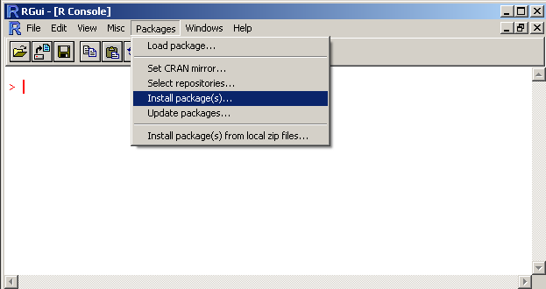
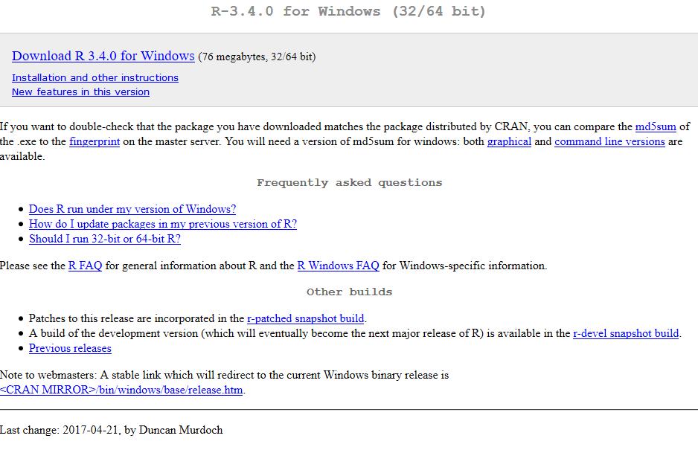
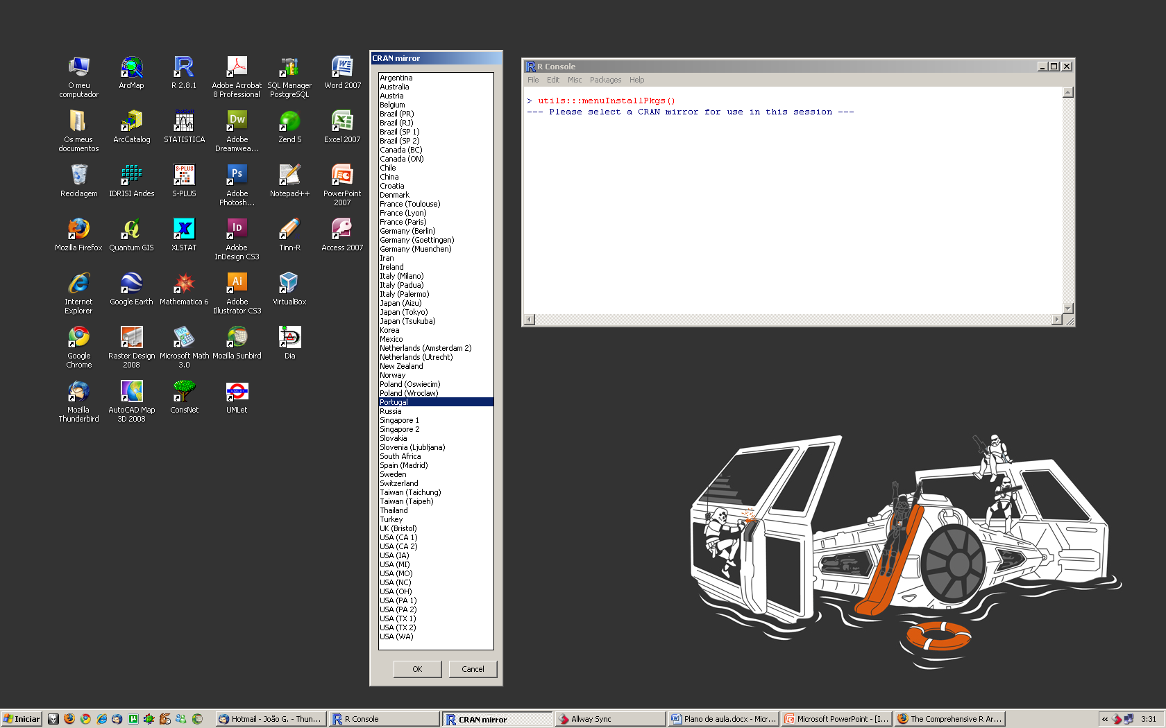
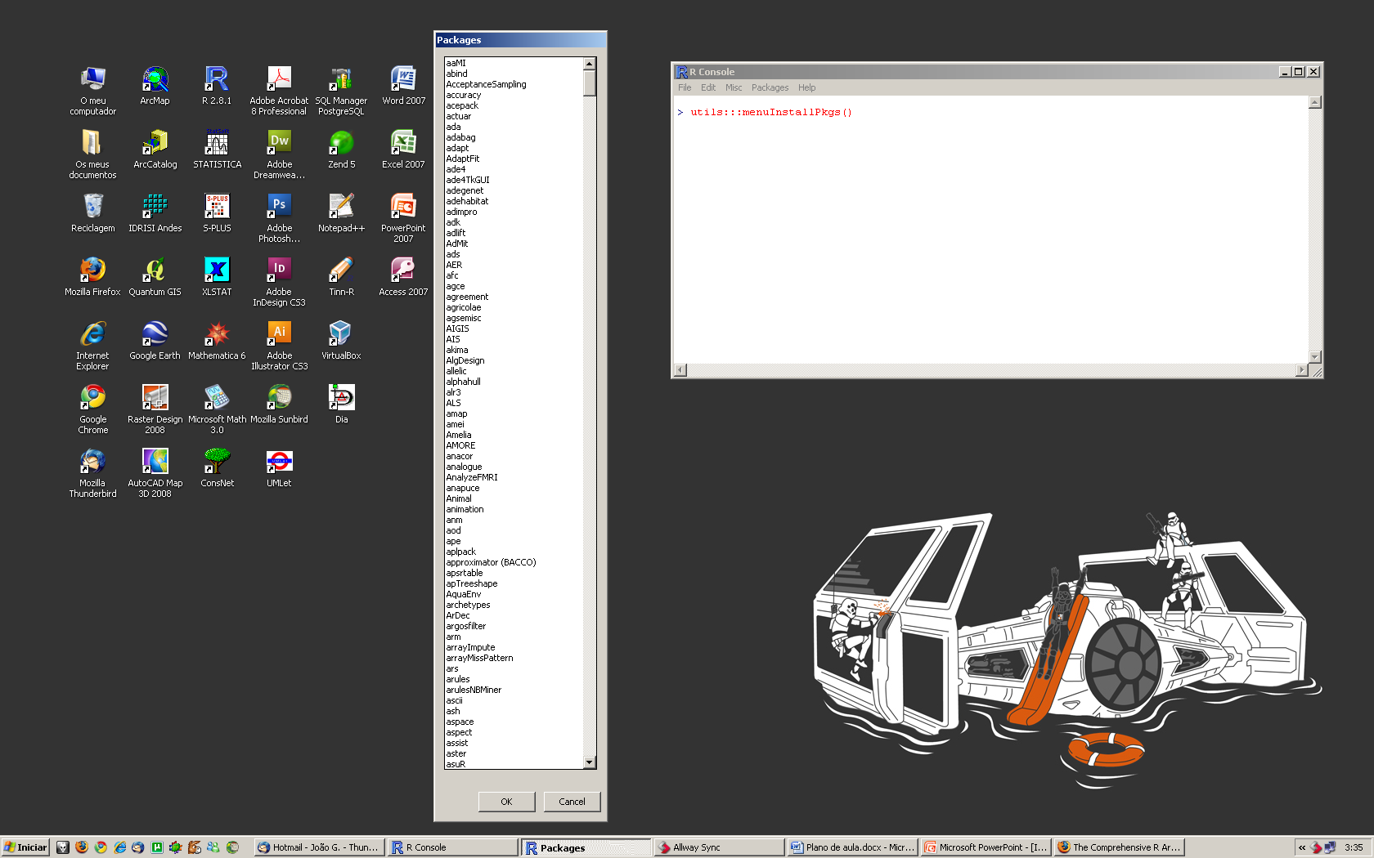
4. How to install R?
Install R-base package: http://cran.r-project.org/ > Download R for Windows > base > Download R 3.4.0 for Windows (62 MB, 32/64 bit) [in Linux the installation procedure is a bit different…]
Contributed packages: Start R > Packages > Install package(s) > CRAN Mirror > Packages > OK

Slide 6
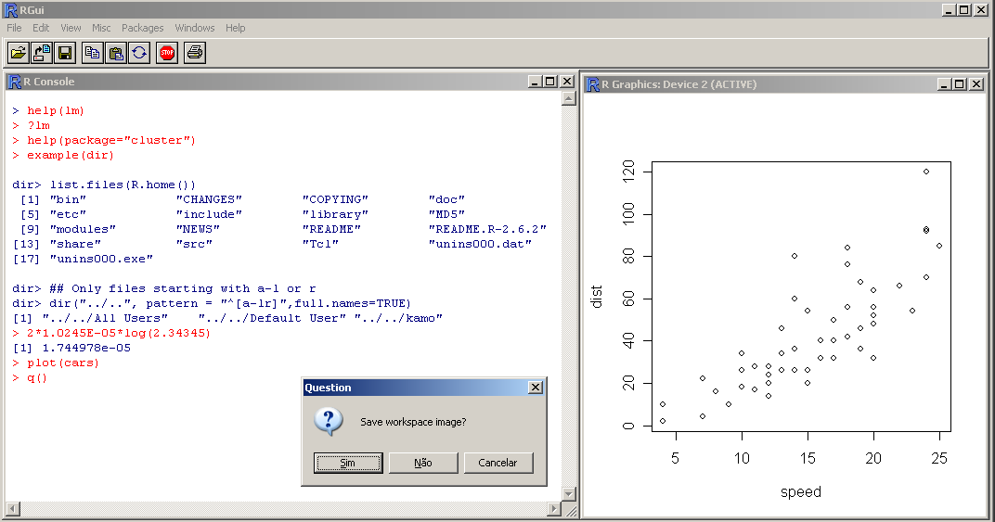
5. First session in R environment R prompt
Graphical device opened by function plot()
R prompt (>)
Operation and result obtained
Exit dialog
(save commands in ‘history’ and data generated in the session)

Slide 7

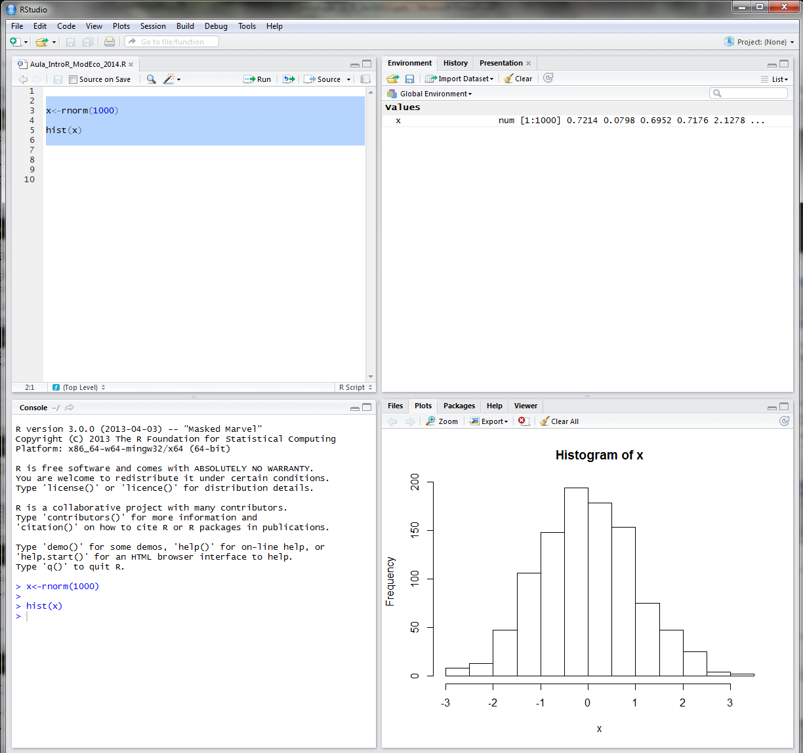
5. First session in R environment Workflow
Working directly in R prompt is not practical
Generally a code editor is used for editing, debugging, testing and running R scripts
Just select the code chunk and press ‘Run’ (or ‘Source’ to run the whole script page)
Simple editing tools:
R – Editor (File > New Script /Open Script)
Notepad
Advanced editors:
RStudio (http://www.rstudio.org)
Notepad++ (http://notepad-plus-plus.org)

Slide 8
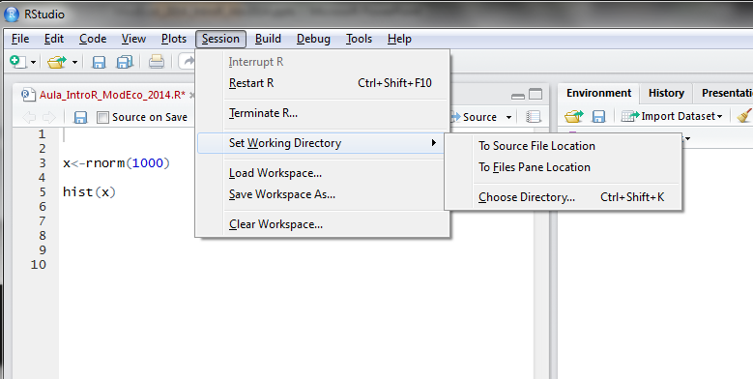
5. First session in R environment Working directory
The working directory is used to read data and/or to save outputs generated by R (e.g., plots, tables)
Avoids having to use complete or long system paths to read/write data
Don’t forget to use either double backslash (“\\”) or single forward slash (“/”) to define paths
# Get the current working directory
getwd()
# Set the working dir
setwd("C:\\EcolMod\\IntroR")
# or
setwd("C:/EcolMod/IntoR")

Slide 9
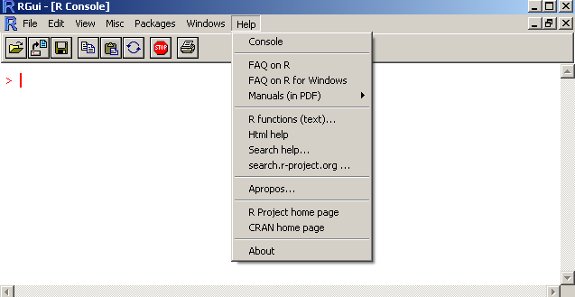
5. First session in R environment Help system
Opções do sistema de ajuda do R:
FAQ
Manuais de base
Documentação sobre funções/pacotes específicos pesquisáveis através de vários processos
Documentação offline e online (e.g.: mailing lists)
R has a very elaborate help system that should consulted whenever necessary
This system has several types of information as well as examples for each statistical procedure available
# starts the offline help system
help.start()
# Searches the documentation by function name
help(sqrt)
?sqrt
# Search help by a term or expression
help.search("linear model")
apropos ("model")
# Search in mailing lists
RSiteSearch("neural networks")

Slide 10
6. Data structures Object orientation
R is an object oriented language which means that each resource stored in memory belongs to a certain class (e.g., vector, matrix, data frame, list)
The class determines the structure of the data, its properties/attributes, ways to access it, as well as, functions/methods applicable
All objects (or variables) have a name and can store different types of data (e.g., integer, real or complex numbers, text strings, expressions)
Object names are case-sensitive. Only characters aA-zZ, numbers 0:9 and the period (.) can be used in names. Object names can’t start by a number
# Input data
x <- 10.5 # press [Enter]
x <- 10.5; y<-log(2.745) # multi-line
x # [1] 10.5
z <- x + y
print(z) # [1] 11.50978
a <- 5
b <- a ^ 2
c <- (b + (1/3) * 45) / 2
c # 20
# Check and delete objects in memory
ls() # [1] "a" "b" "c" "x" "y" "z“
objects() # [1] "b" "c" "x" "y" "z"
rm(a) # Remove object a

Slide 11
6. Data structures Vectors
# Creates a numeric vector
elev.max <- c(1993,1507,1205,1222)
# Text string vector(use "" or '' to input)
region <- c("Guarda","Braga","Leiria",'Aveiro')
length(elev.max) # [1] 4
mode(elev.max) # [1] "numeric"
mode(region) # [1] "character"
# Type/mode coercion
x <- c(13,15,35,10,"Hello!")
x # [1] "13" "15" "35" "10" "Hello!"
# Unknown values(NA)
y <- c(1475.98, 564.65, 375.45, NA, 12.34)
# Change the names of each value in the vector
names(elev.max) <- region
print(elev.max)
# Guarda Braga Leiria Aveiro
# 1993 1507 1205 1222
# Access/change vector values
elev.max[2] # 1507
elev.max["Braga"]
elev.max[1] <- 1995
Allows storing one or more values of the same type (e.g., integer numbers, strings of text)
Each element of the vector can be individually accessed (indexation)
All vectors have a ‘mode’ and a ‘size’ attributes
Modes: character (stores text values), logical (boolean TRUE/FALSE values), numeric (integer or real values) and complex numbers
The function length() can be used to get the vector size
The concatenation function c() allows creating vectors with multiple elements/values

Slide 12
6. Data structures Indexation
x <- c(0, -3, 4, -1, 45, 90, -5)
x > 0
#[1] FALSE FALSE TRUE FALSE TRUE TRUE FALSE
# Boolean indices
x[x > 0]
# [1] 4 45 90
x[x >= -2 | x > 5]
# [1] 0 4 -1 45 90
x[x > 40 & x < 100]
# [1] 45 90
# Integer positions
x[c(1,2)]
# [1] 0 -3
x[-c(2,4,7)]
# [1] 0 4 45 90
# Name index
names(x)<-letters[1:7]
# a b c d e f g
# 0 -3 4 -1 45 90 -5
x[c("a","e","g")]
# a e g
# 0 45 -5
To select or extract a subset of elements from a vector we use square brackets [] with a Boolean index (TRUE is select FALSE it is not) or an integer index (denoting positions)
Multiple logical operations can be used to select elements
If vector elements have names then it’s possible to select them using an index vector containing selected names
If the operator minus (-) is used before an integer index it allows to exclude elements

Slide 13
6. Data structures Matrices
Matrices allow to store data of only one given type in a bi-dimensional structure
Names for rows and columns can be used for better indexation/selection
The functions nrow() and ncol() allow to get the number of rows and columns
Specific operations can be applied, such as: matrix multiplication (%*%), transpose (t()), determinant (det()), inverse (solve()), etc.
Functions rbind() and cbind() allow appending more rows or columns to the end of the matrix
# Create a matrix by setting the number of rows
x <- matrix(c(1,0,0,0,1,0,0,0,1), nrow = 3)
# [,1] [,2] [,3]
# [1,] 1 0 0
# [2,] 0 1 0
# [3,] 0 0 1
v <- c(1,2,3,4,4,3,2,1) # Fill by row
m <- matrix(v, byrow = TRUE, nrow = 2)
# [,1] [,2] [,3] [,4]
# [1,] 1 2 3 4
# [2,] 4 3 2 1
attributes(x) # Object attributes
# $dim [1] 3 3
# Set row and column names
rownames(m) <- c("Row.1","Row.2")
colnames(m) <- c("Col1","Col2","Col3","Col4")
# Col1 Col2 Col3 Col4
# Row.1 1 2 3 4
# Row.2 4 3 2 1
# Indexation: matrix[row, column]
m[1,] # Row 1
m[1:2, c(3, 4)] # Row 1 to 2 and columns 3 and 4
m["Row.1", "Col1"] # Row named "Row.1" and # column named "Col1"

Slide 14
6. Data structures Data frames
x <- 1:4; n <- 10
data.frame(x, n) # creates a new data frame
# x n
# 1 1 10
# 2 2 10 ...
# Load a test dataset containing iris species
# functional attributes
data(iris)
is.data.frame(iris)
# [1] TRUE
# Data frame indexation
iris[1, ]
# Sepal.Length Sepal.Width ...
# 1 5.1 3.5
iris[2, 1]
# [1] 4.9
iris$Sepal.Length
# [1] 5.1 4.9 4.7 4.6 5.0 5.4 ...
iris$Species
# [1] setosa setosa setosa ...
# Levels: setosa versicolor virginica
iris[iris$Sepal.Length >= 7, "Sepal.Width"]
# [1] 3.2 3.0 3.0 2.9 3.6 ...
iris[(iris$Sepal.Length > 6) & (iris$Sepal.Width > 3)]
# Sepal.Length Sepal.Width Petal.Length ...
# 51 7.0 3.2 ...
Data frames are probably the most frequent data structure used to store and analyse ecological data from multiple fields
Data frames can store multiple data types which makes them much more flexible in comparison to matrices
Similar to a MS Excel table

Slide 15
7. Plots in R
# Scatterplot of a data frame
data(iris)
plot(iris)
# Boxplot of Sepal.Length by species boxplot(Sepal.Length~Species,data=iris)
# Empirical Cumulative Distribution Function
plot(ecdf(rnorm(500)),verticals = TRUE,col.points = 'blue',col.hor = 'red', col.vert = 'bisque')
# Plot function sin(x)
plot(sin,-pi,2*pi)
R has very powerful resources to generate plots and graphs
A large variety of plots can be created:
plot(x, y, …)
hist(x, breaks, freq, plot)
boxplot(formula, data, …, subset)
It’s possible to combine multiple functions to develop specific plots adapted to user needs

Slide 16
8. Reading/writing data files
R has several functions to read and write data from or to files (e.g., CSV, tab delimited, Excel, DBF, ODS,…, ESRI Shapefile, GeoTIFF, …)
Ecological data is generally stored in simple/raw data formats with values separated by whitespaces, tabs or commas. In these cases the following functions can be used to read/write data:
Read:
read.table(file, header, sep, row.names, col.names, ...)
read.csv()
read.delim()
Write:
write.table(x,file, header, sep, row.names, col.names, ...)
write.csv()
From the file R creates a data frame that stores the data in RAM memory
Several read/write options can be used to maintain data structure, namely:
header – does the file contains a header?
sep – field separator character
row.names – row names
col.names – column names

